Slide 1
Spatial Analyses of Child Maltreatment Allegations during COVID-19 of 2020
Presenter: Vicky Albert
Discussant: Annie Hsu

Slide 2
Summary
Research question:
What were the spatial patterns of distribution for increasing unemployment rates?
How do the spatial patterns of shifts in allegations of child neglect compare to those of child physical abuse allegations?
What was the correlation between alterations in child maltreatment and shifts in the economy or school closures?
Hypothesis: given an economic downturn and school closures, one would anticipate a rise in child maltreatment allegations
Spatial Analyses
Job losses
School closures
Child maltreatment allegations
Covid-19 Pandemic

Slide 3
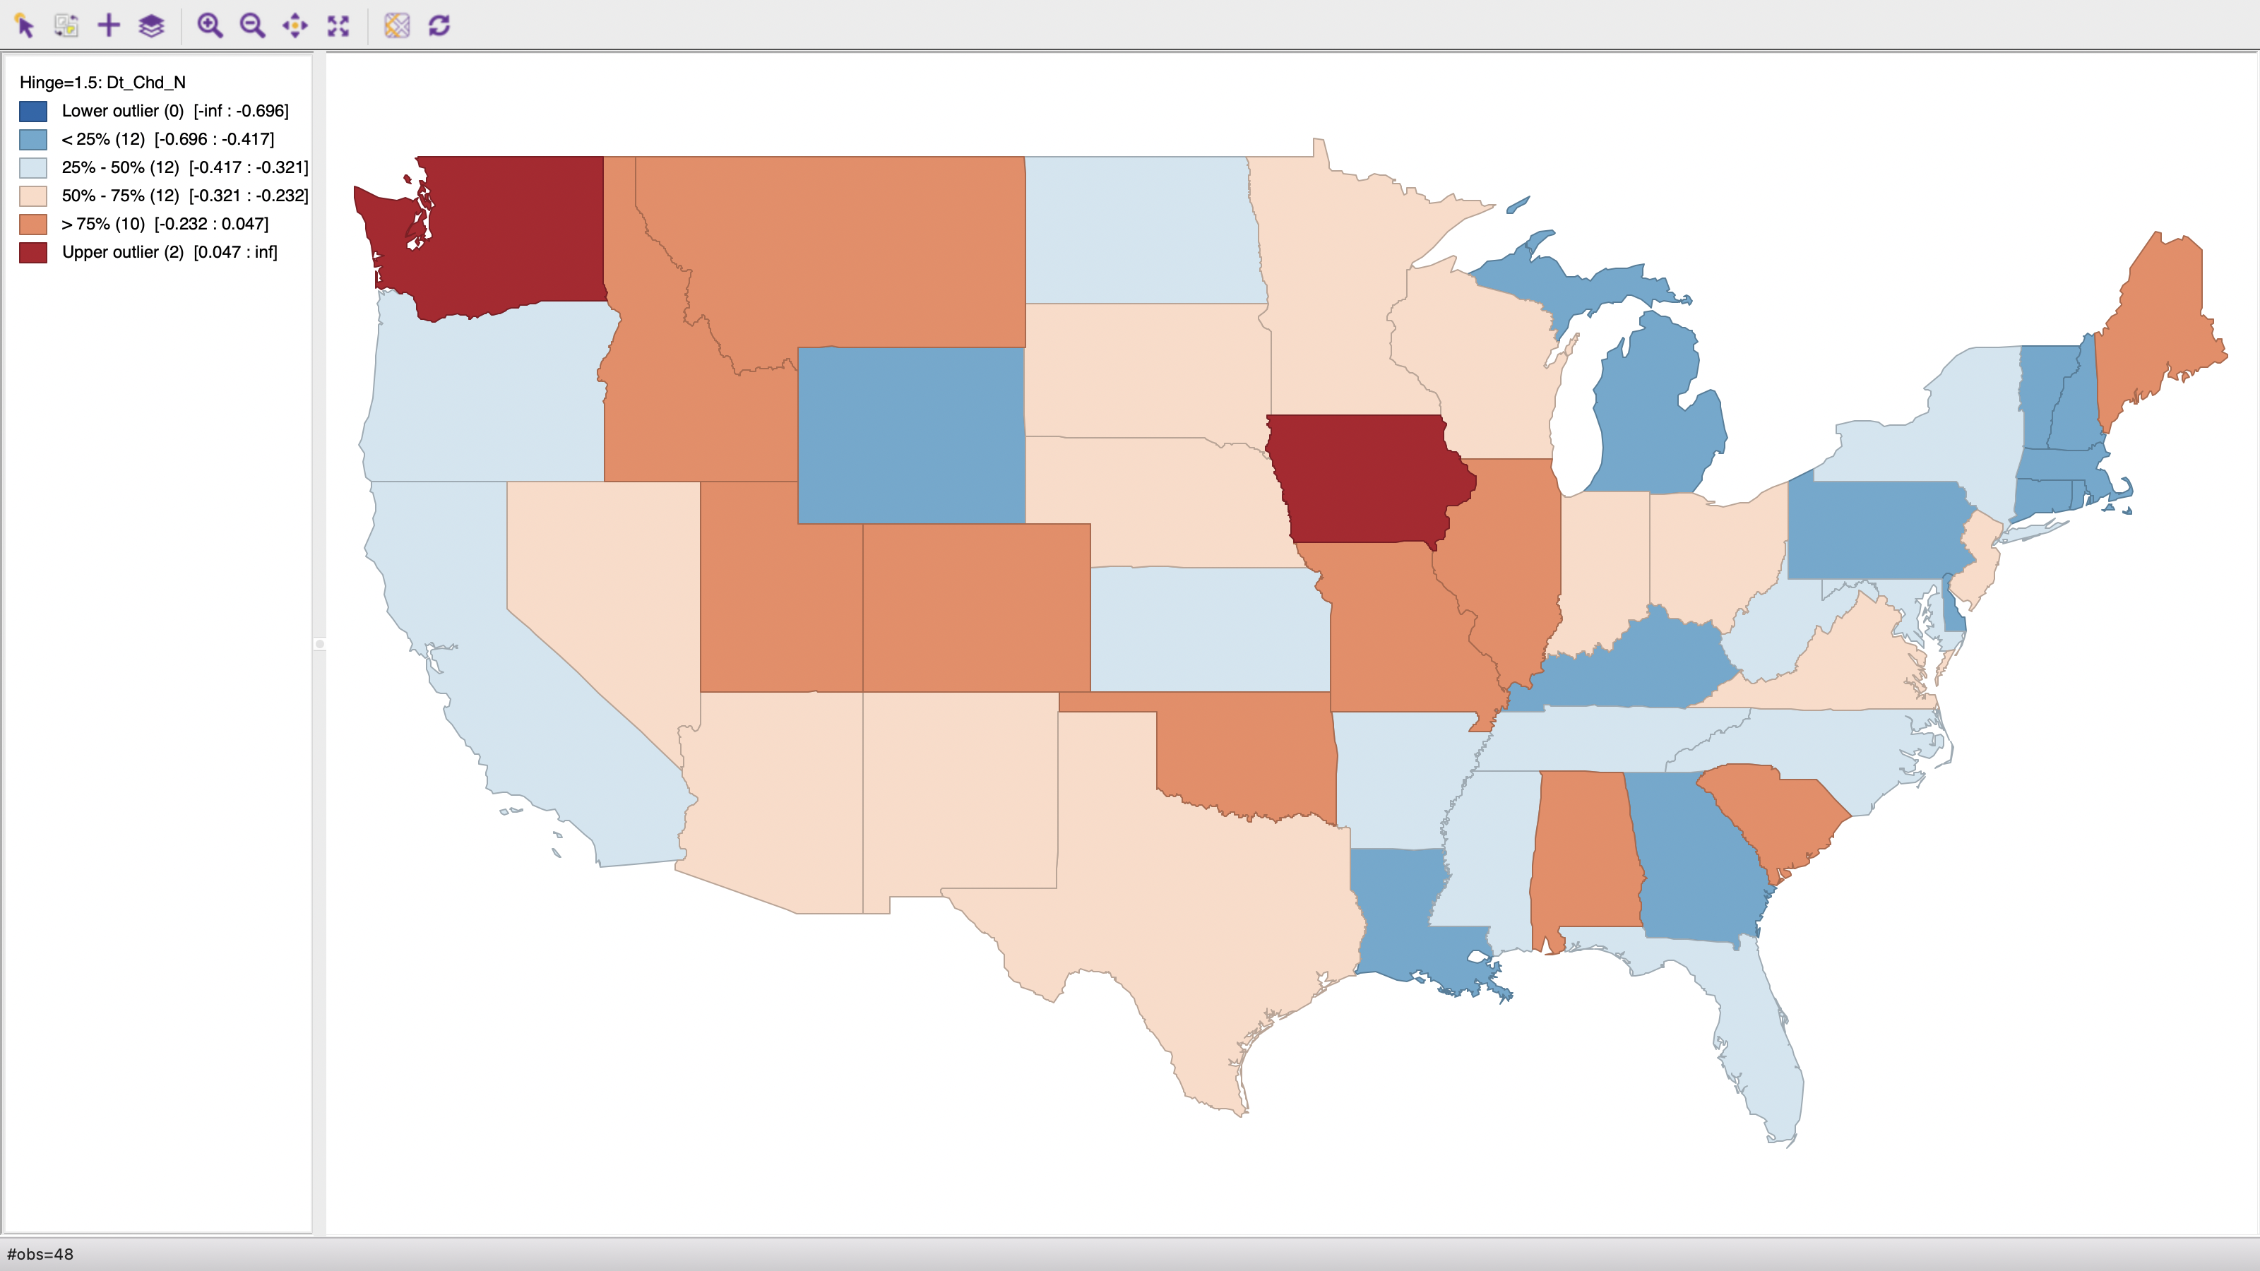
Conclusion
Child neglect allegation decreased in most states (not WA and IA)

Slide 4
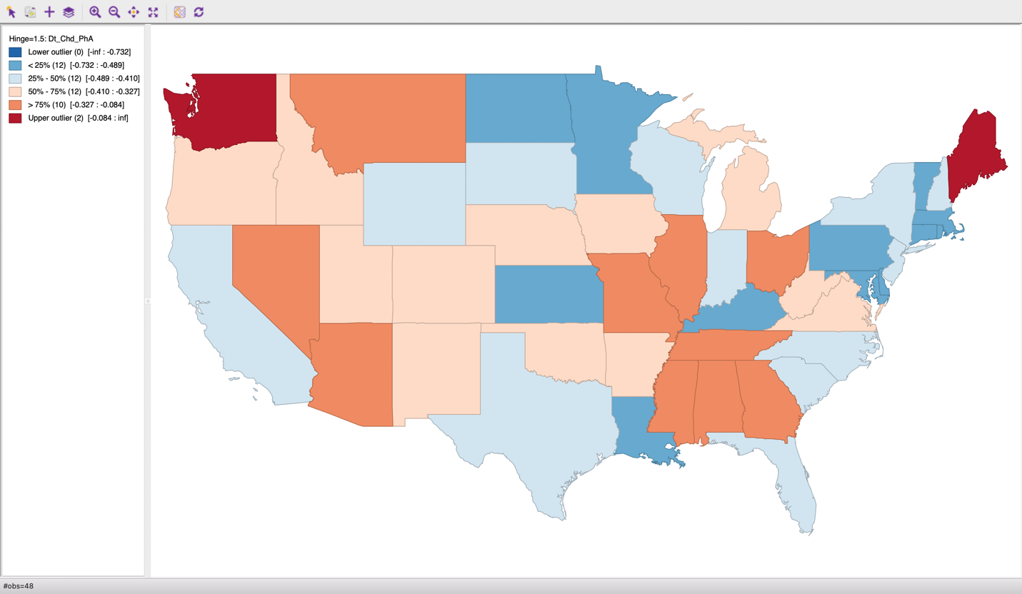
Conclusion
Child physical abuse allegation decreased in most states

Slide 5
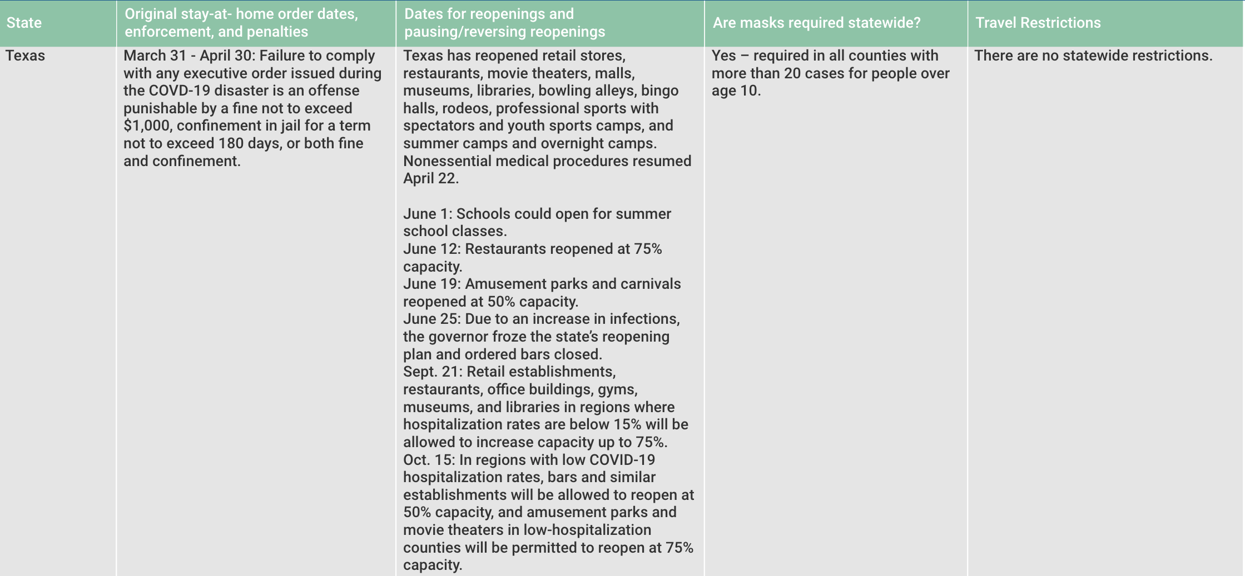
Might be interested to consider…
1. Stay at home time:
Compared to regions with lower rates of staying at home, children residing in areas with higher rates of staying at home were more likely to be both reported for and confirmed as victims of maltreatment, especially neglect (Bullinger et al., 2021)
2. Reopen policy:
(Source: National Academy for State Health Policy)
Notes:
Link: https://nashp.org/state-tracker/2020-covid-19-state-restrictions-re-openings-and-mask-requirements/

Slide 6
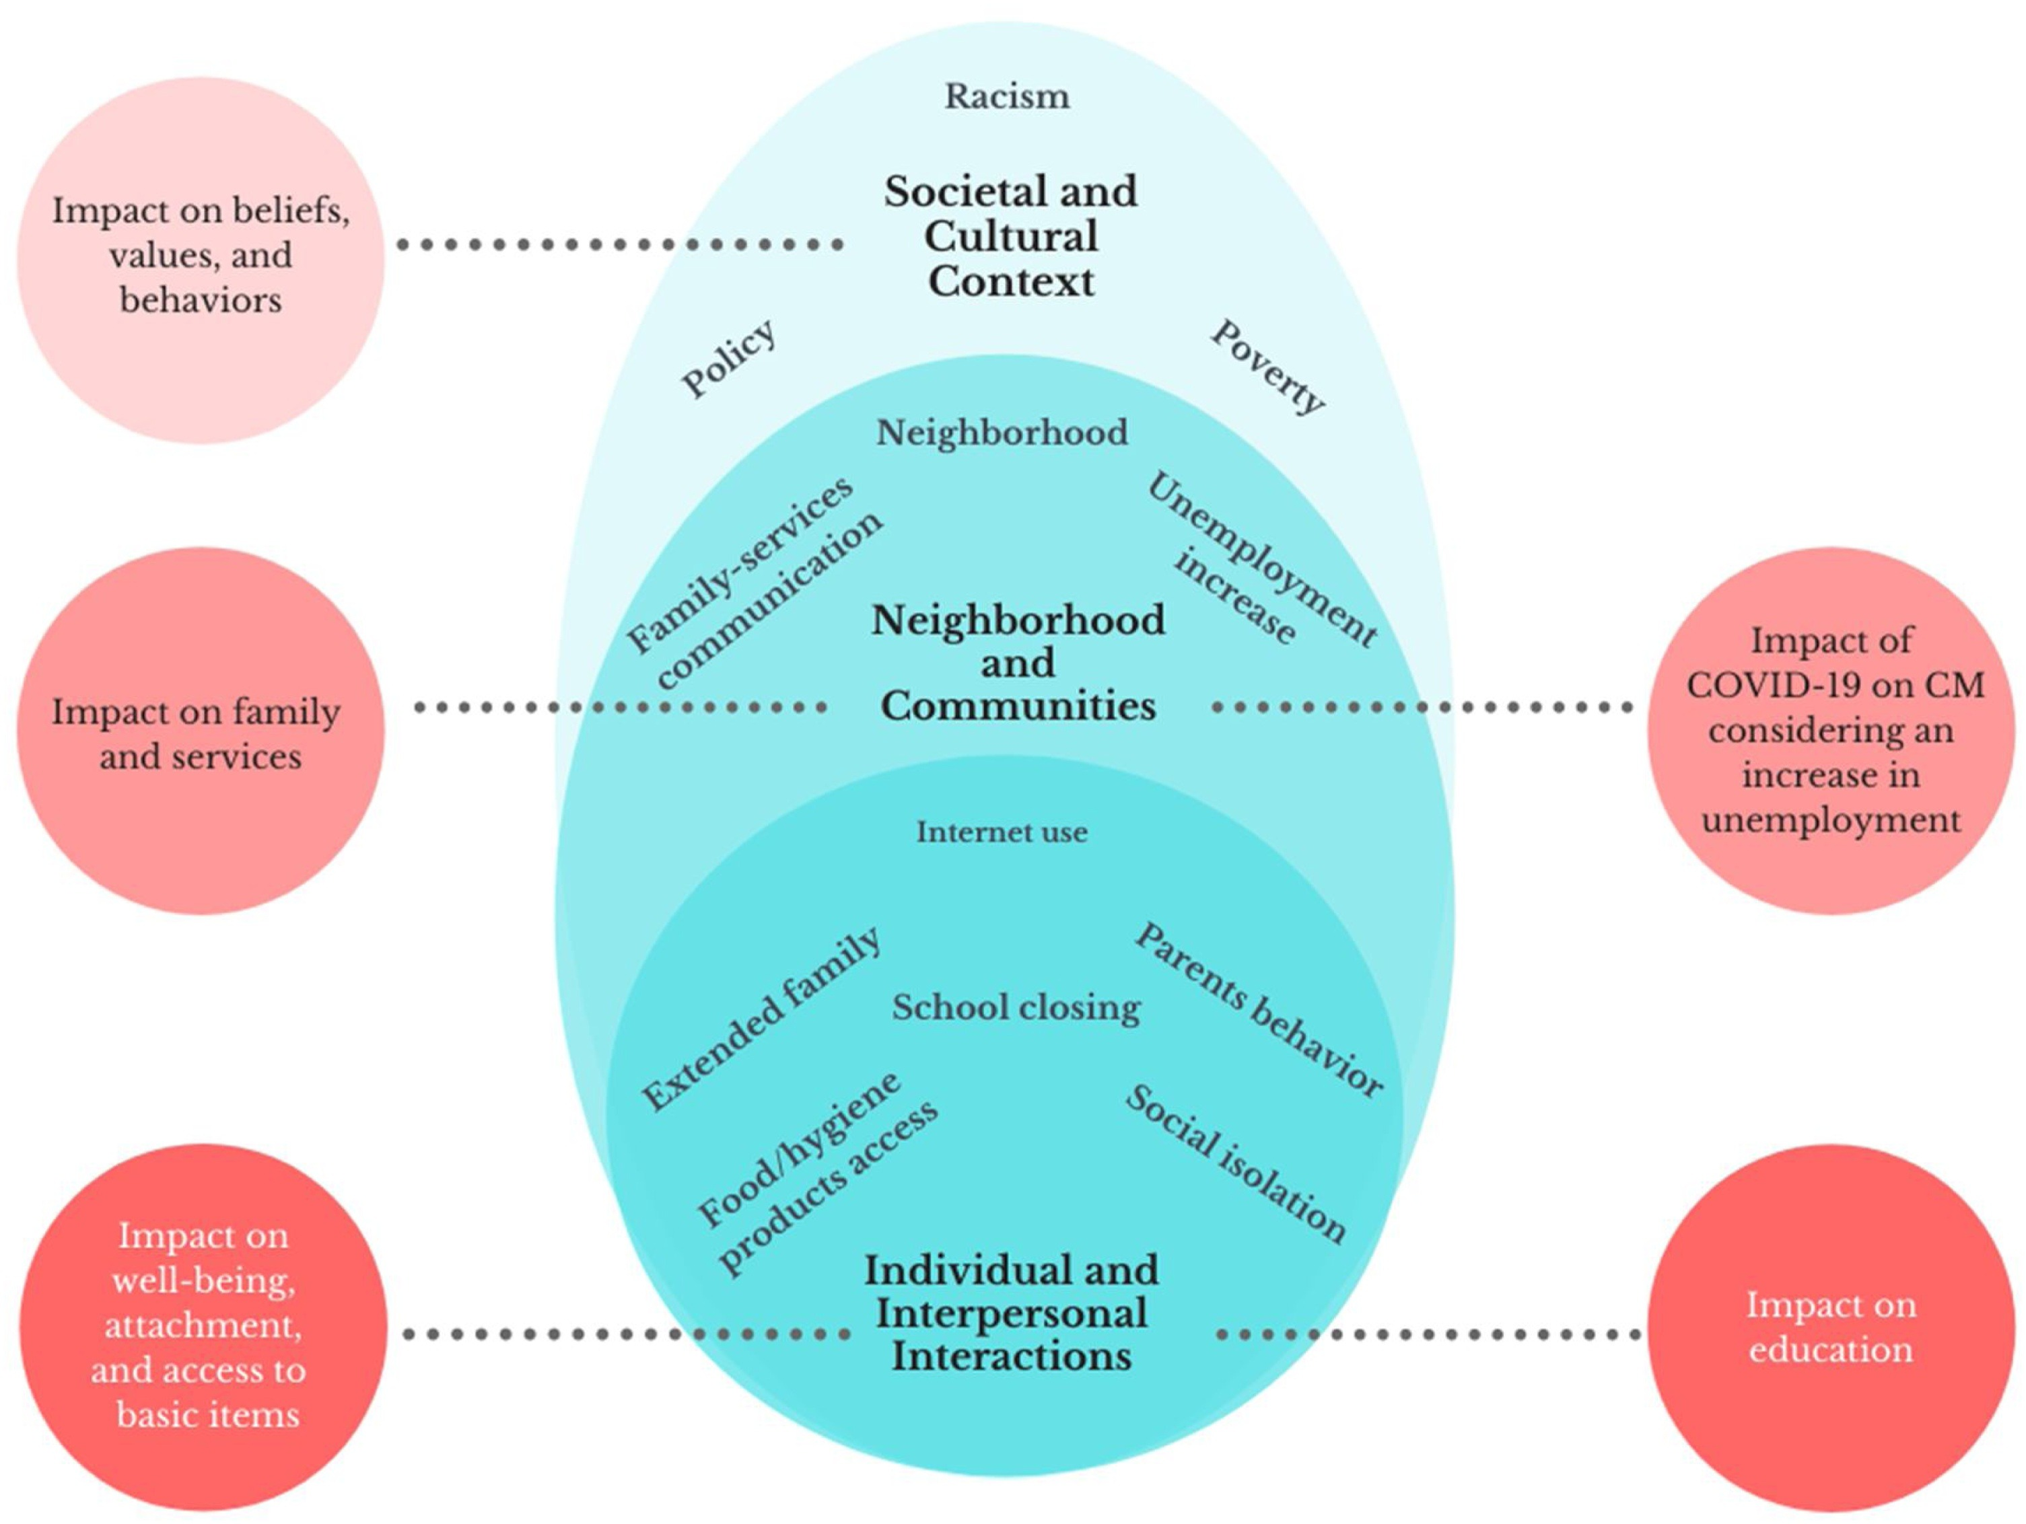
Might be interested to consider…
3. Child protection policy/service:
Source: Katz et al. 2021
Notes:
Source: https://www.sciencedirect.com/science/article/pii/S0145213420304798

Slide 7

Might be interested to consider…
4. Child welfare:
GAO (Government Accountability Office) survey:
Child welfare authorities in 35 states indicated that they had proactively contacted families previously in contact with the agency to offer assistance.
State officials had introduced a range of virtual services:
52 states facilitated visits for children in foster care to interact with their biological families
47 states participated in court hearings virtually
35 states offered virtual health services
Notes:
Source: https://www.gao.gov/assets/gao-21-483.pdf

Slide 8
Might be interested to consider…
5. Parenting:
Families with children face distinct challenges, including school closures, disrupted childcare arrangements, parents taking on additional responsibilities like homeschooling, potential financial difficulties, and limited personal space within the household.
Parents encountered a combination of stressors as a result of the COVID-19 pandemic. Concerning particular challenges, approximately 21%–47% of parents reported that their children underwent changes in health and learning due to COVID-19 (Brown et al. 2020)
Amid a pandemic, parents rely on both informal (social) and formal (specialized professional) support. Additionally, there is a lack of research on the psychosocial effects of pandemics on children and youth under the age of 20, highlighting the necessity for further investigation in this area (Lateef et al. 2021)
Notes:
Source: https://www.sciencedirect.com/science/article/pii/S0145213420303549

